Slide 1
Network Adequacy
Data Maintenance Planning
Important note:
The Provider-Type categories discussed in this July 16, 2024 meeting was reworked and will be superseded by discussions in the Aug 15, 2024, meeting. The initial “seed” template will reflect discussions of the Aug 15, 2024 meeting with enhancements to help issuers process the list.
10:00 am-11:00 am Central
July 16, 2024
Regulatory Health Link Division,
Arkansas Insurance Dept., Dept. of Commerce

Slide 2
Agenda
Introductions
Commissioner’s message.
Arkansas DOI’s position on the CCIIO standards.
PY2026 CCIIO T&D standards
what are they and how are they different.
Timelines on changes.
Change challenges.
Timeline for changes to Rule 106.
Next steps.

Slide 3
Commissioner’s message

Slide 4
A message from Alan McClain Commissioner Arkansas Insurance Department

Slide 5
Arkansas DOI’s position on the CCIIO standards.

Slide 6
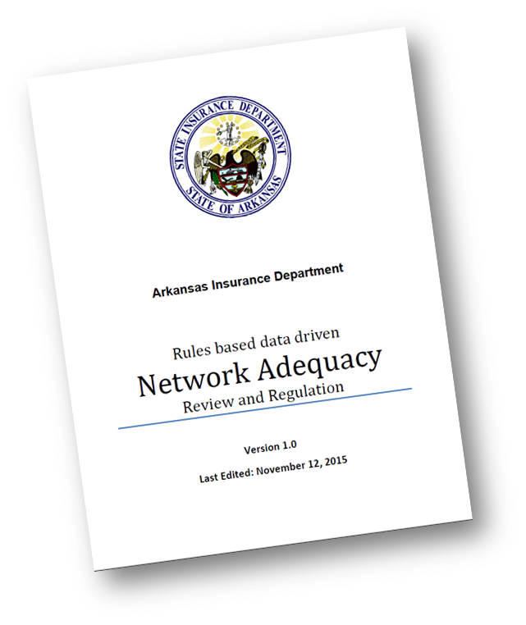
Guiding Principles
Arkansas Network Adequacy Program Architecture document articulates Principles (from the discipline of Enterprise Architecture).
The Principles help guide enterprise behavior when at the cross-roads of important or difficult decision-making.

Slide 7
Guiding Principles- contd
Align with available Federal/National standards or efforts if feasible
Build collaboratively – across organizations, disciplines
Perfection should not be the enemy of the good
Build incrementally
Apply Pareto’s 80-20 principle for every phase
Seek lessons learned – from others and within.

Slide 8
CCIIO' T&D standards

Slide 9
CCIIO’s Time and Distance Standards
First communicated in CCIIO’s PY2023 Letters to Issuers.
To be implemented for PY2026, as a minimal standard for marketplace QHPs in all state models including Arkansas SBE-FP model.
Time and distance requirements vary by 1) Provider Type & 2) Medicare (Part A) county designation
Number of Provider-Types to be monitored will increase from what AID currently covers.
Will have a justification system to help with a lack of certain provider of a certain type.
CCIIO has not yet proposed any data governance process over provider type classification (like the PTNP process in Arkansas).

Slide 10
How are CCIIO’s Network Adequacy Metrics different?
Using Urologists as an example to explain the conceptual differences
Rule 106
Average distance from consumers to the nearest provider-type,
computed separately for each county, not to exceed 60 miles.
CCIIO T&D Standards
At least 90% consumers should be covered within the T&D specifications for the Medicare Part A county designation.
5 Types of county designations ranging from 20 minutes/10 miles in Large Metros to 110 minutes/100 miles for the most rural CEAC designation
Driving distance standard for County Designation-Provider Type
Avg$=\frac{d1+d2+d3+…+dn}{n}$
d_{x}
Provider-Type location
d₂
County boundary
d₁
Rule 106 Metric: Avg. distance in miles
CMS-CCIIO’s PY2026 Metric: Percent Covered

Slide 11
Timeline on changes

Slide 12
Timeline for changes
We are engaged in this round
Last round before we go live with CCIIO T&D stds
PTNP Round 2 of 2024
PTNP Round 1 of 2025
Certification Review for PY2026
mid-July, 2024
mid-Nov, 2024
mid-Dec, 2024
mid-May, 2025
mid-May, 2025
Jan 1, 2026

Slide 13
Change challenges

Slide 14
Provider Type Differences CMS vs AID
CMS Requirements
AID Requirements
45 requirements
11 Facility
34 Individual
Providers classified by specialty; specialties included in requirement
21 requirements
7 Facility
14 Individual
Providers placed directly in requirement categories

Slide 15
AID Pool Organization

Slide 16
AID Pool Organization

Slide 17
CMS Pool Organization

Slide 18
CMS Pool Organization

Slide 19
CMS Pool Organization

Slide 20
CMS Pool Organization

Slide 21
CMS Pool Organization

Slide 22
CMS Pool Organization

Slide 23
CMS Pool Organization

Slide 24
CMS Pool Organization

Slide 25
CMS Pool Organization
CMS Requirements are generally more detailed:
More specialties
Broader categories subdivided
Oncology
Cardiology
We will preserve two categories AID has that CMS does not:
Substance Use Disorder Providers (FPA01)
Pharmacies, which are not included (FFA01)

Slide 26
Substance Abuse Disorder Providers
AID has two categories in the PTNP:
C040:Mental Health/Behavioral Health Providers
C050: Substance Use Disorder Providers
CMS does not separate substance use disorder providers.

Slide 27
Substance Abuse Disorder Providers

Slide 28
Substance Abuse Disorder Providers

Slide 29
CMS vs. AID Conclusions
4 of 45 CMS requirements (1 Facility, 3 Individual) have multiple specialties.
Additionally, at least four AID requirements would be split between two or more CMS requirements.
This makes any direct mapping between current PTNP and new requirements impossible.
???

Slide 30
PTNP 2.0

Slide 31
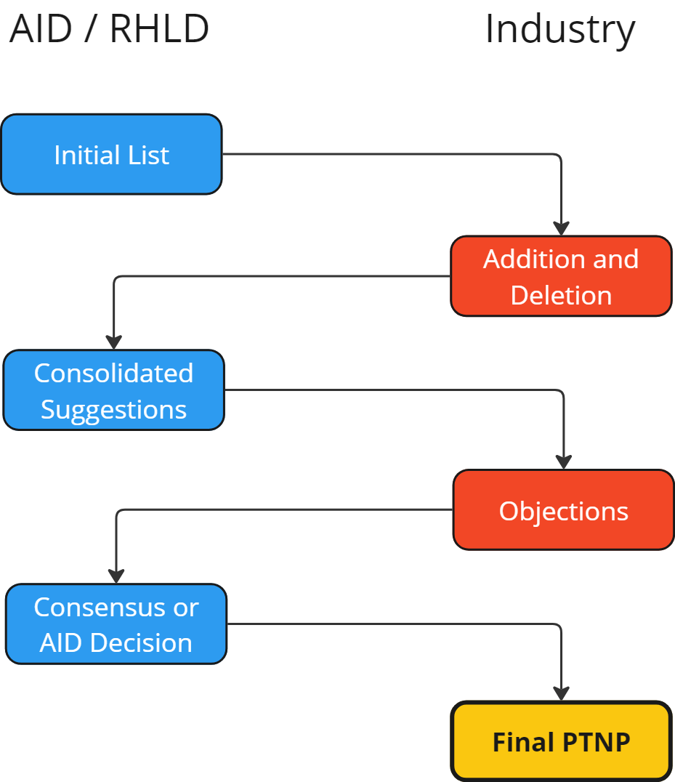
PTNP Reboot
Current process from issuers’ perspective will remain intact.

Slide 32
PTNP Reboot
All previous requirements will reset to the CMS requirements.
Pharmacies and Outpatient Substance Use Disorder added
PTNP will reference 67 (66+pharmacies) specialties rather than direct NA requirement categories.
Only Pharmacy NPIs will be transferred to the new initial PTNP list.
All other specialties in the PTNP will be initially seeded from PY2025 NA Template submissions.

Slide 33
PTNP Reboot
Problem
Solution
Provider classification in NA Templates is not driven by consensus.
Stale providers removed from PTNP may still be present in NA Templates.
Industry participation in the upcoming PTNP round is essential!
Data mining of APCD to suggest removal of providers with no claims.

Slide 34
APCD Utilization
No automatic removal.
Recommendation for removal based on:
More than two years since last claim either as service provider or billing NPI.
No claim history in APCD and single issuer listing.
PARTICIPATION IN VOTING/OBJECTION ROUND IS ESSENTIAL

Slide 35
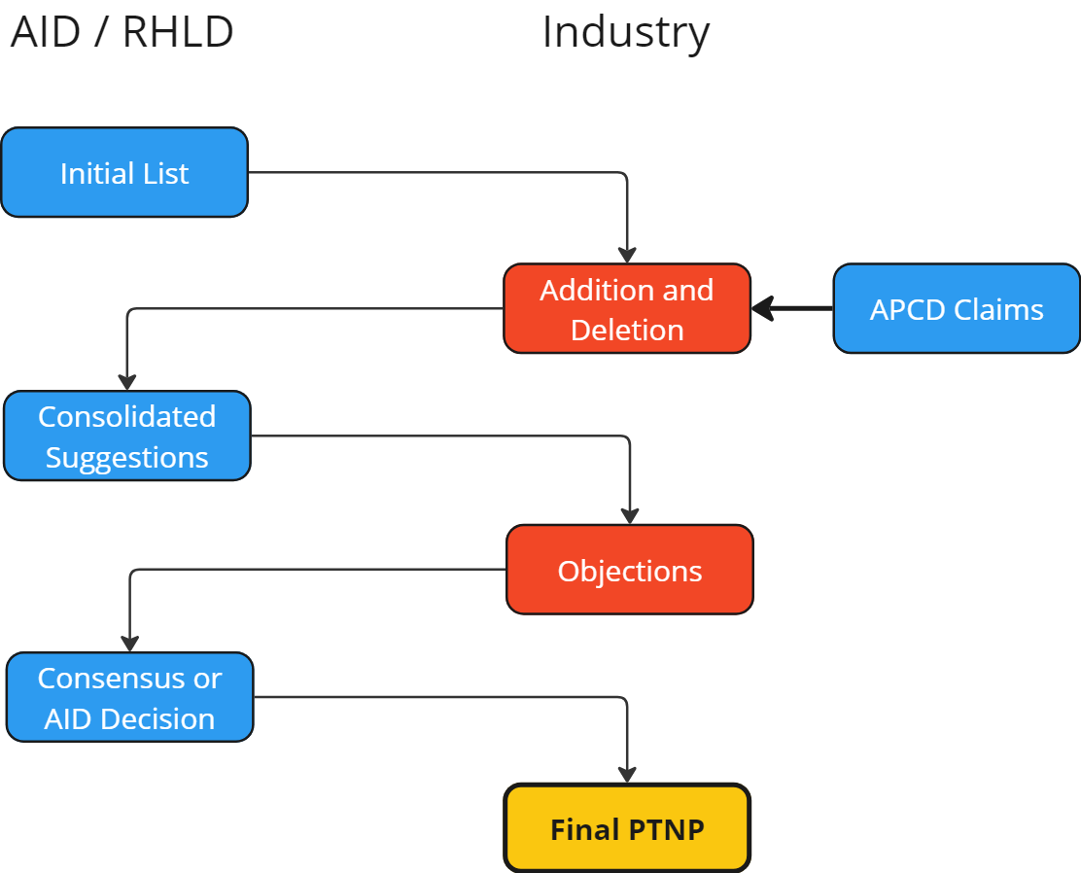
APCD Utilization
AID will participate in the add/delete phase:

Slide 36
PTNP Takeaways
PTNP Categories will shift to CMS Specialties
NA Evaluation Criteria will shift to CMS Requirement Categories
Process will remain the same with two changes
Initial list for next round will contain number of issuers listing NPI and last claim date for reference
AID will participate in the add/remove round to recommend removal of NPIs with no recent claims
INDUSTRY PARTICIPATION IN AND CAREFUL ATTENTION TO THE NEXT PTNP ROUND IS OF UTMOST IMPORTANCE!

Slide 37
Timeline for changes to Rule 106

Slide 38
Rule 106 amendment
Too many unresolved dependencies to volunteer a timeline for Rule 106 amendment at this stage.

Slide 39
Questions?
Email
RHLD.DataOversight@arkansas.gov

